Slide 1
Machine Learning in R
Morgan Gant

Slide 2
Data Set: Breast Cancer
- Idea stemmed from a Math Conference​ and Family
- Primary goals were to learn basic machine learning in a different language
- ​Areas of growth for future opportunities
​

Slide 3
Introduction
Occurs when healthy cells change and reproduce rapidly/abnormally, then they turn into tumors
Tumors can occur in different areas of the breast: Glands that make milk, ducts that hold the milk, and other tissue areas.
Signs:
Lobes or thickening of tissue in the breast, change of size and appearance of breast, changes to the skin over the breast
Doctors think 5%-10% of breast cancers are link to gene mutations that are inherited
Risks:
Being female, older in age, radiation exposure, obesity, personal history of breast conditions/breast cancer, etc.

Slide 4



Data Description
32 Columns
570 Rows
Target variable
Mix of categorical and numerical variables
Most focus on the lobe specifically
Each row represents a patient
There are no missing values
Diagnosis
0 is Benign
1 is Malignant

Slide 5
PRIMARY GOALS
Explore Data
2. Find Top 10 Variables
3. Pick 3 Machine Learning Models
4. Learn how to run them in R
5. Pick a performance Metric
6. Compare the performance

Slide 6
Diagnosis Separation

Slide 7
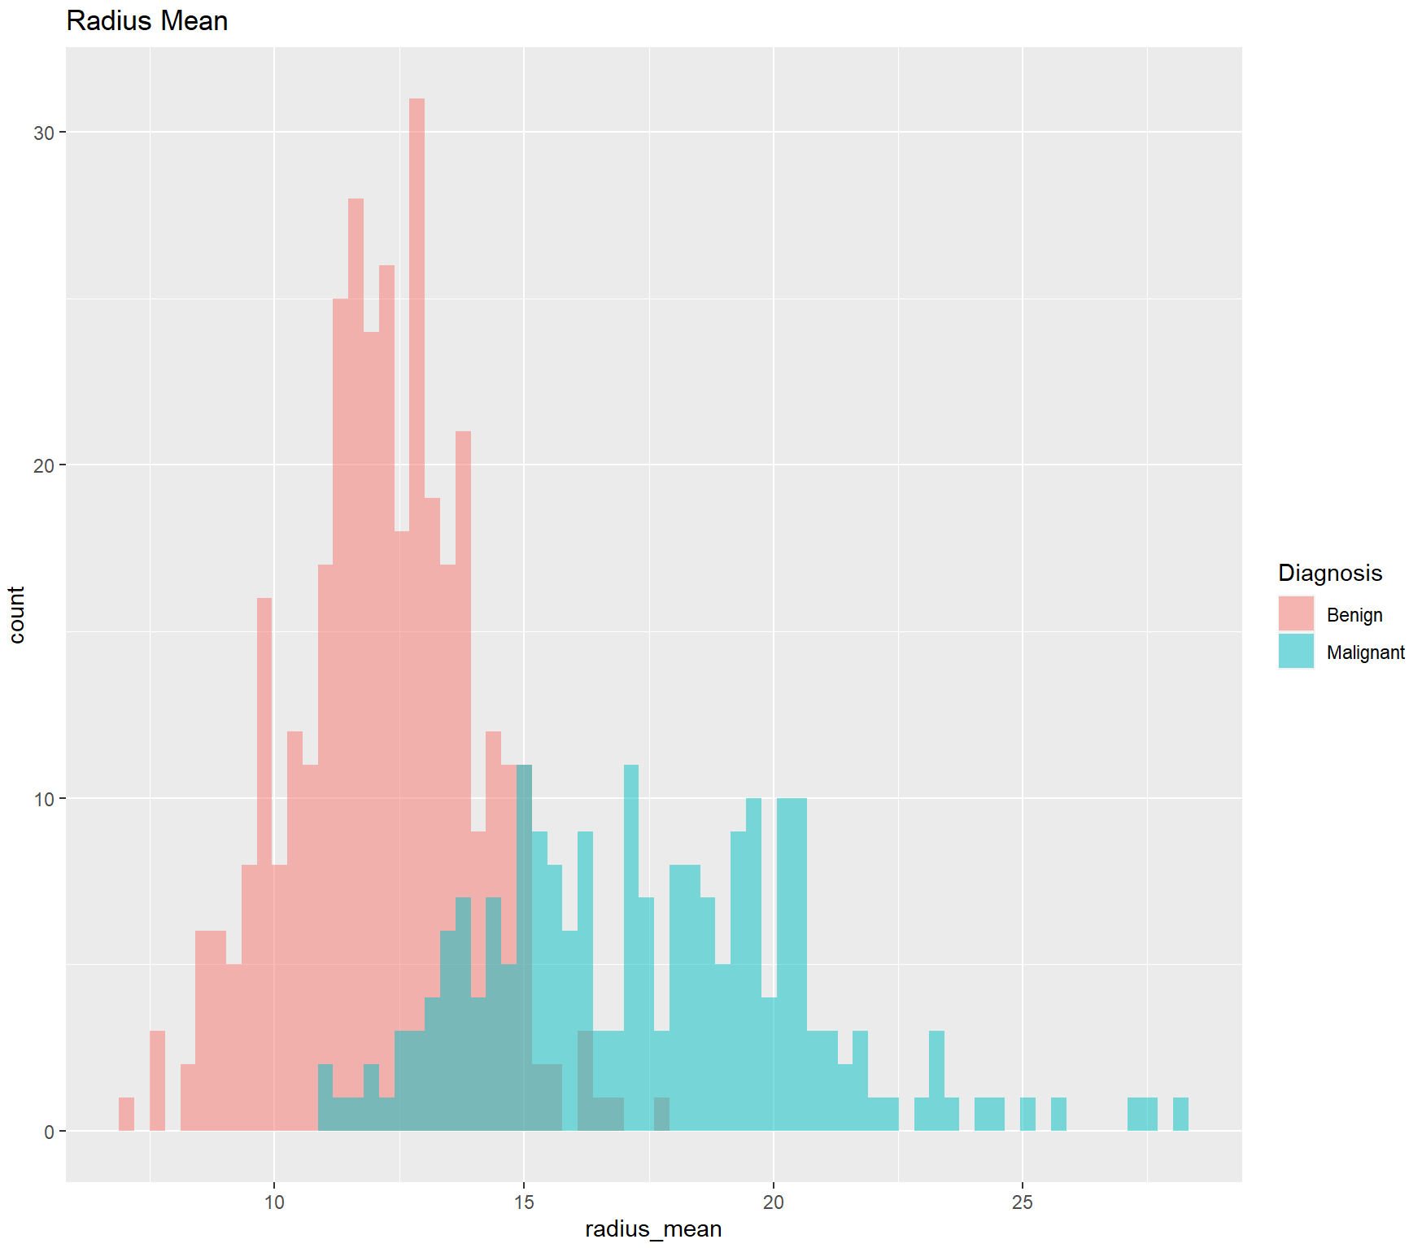
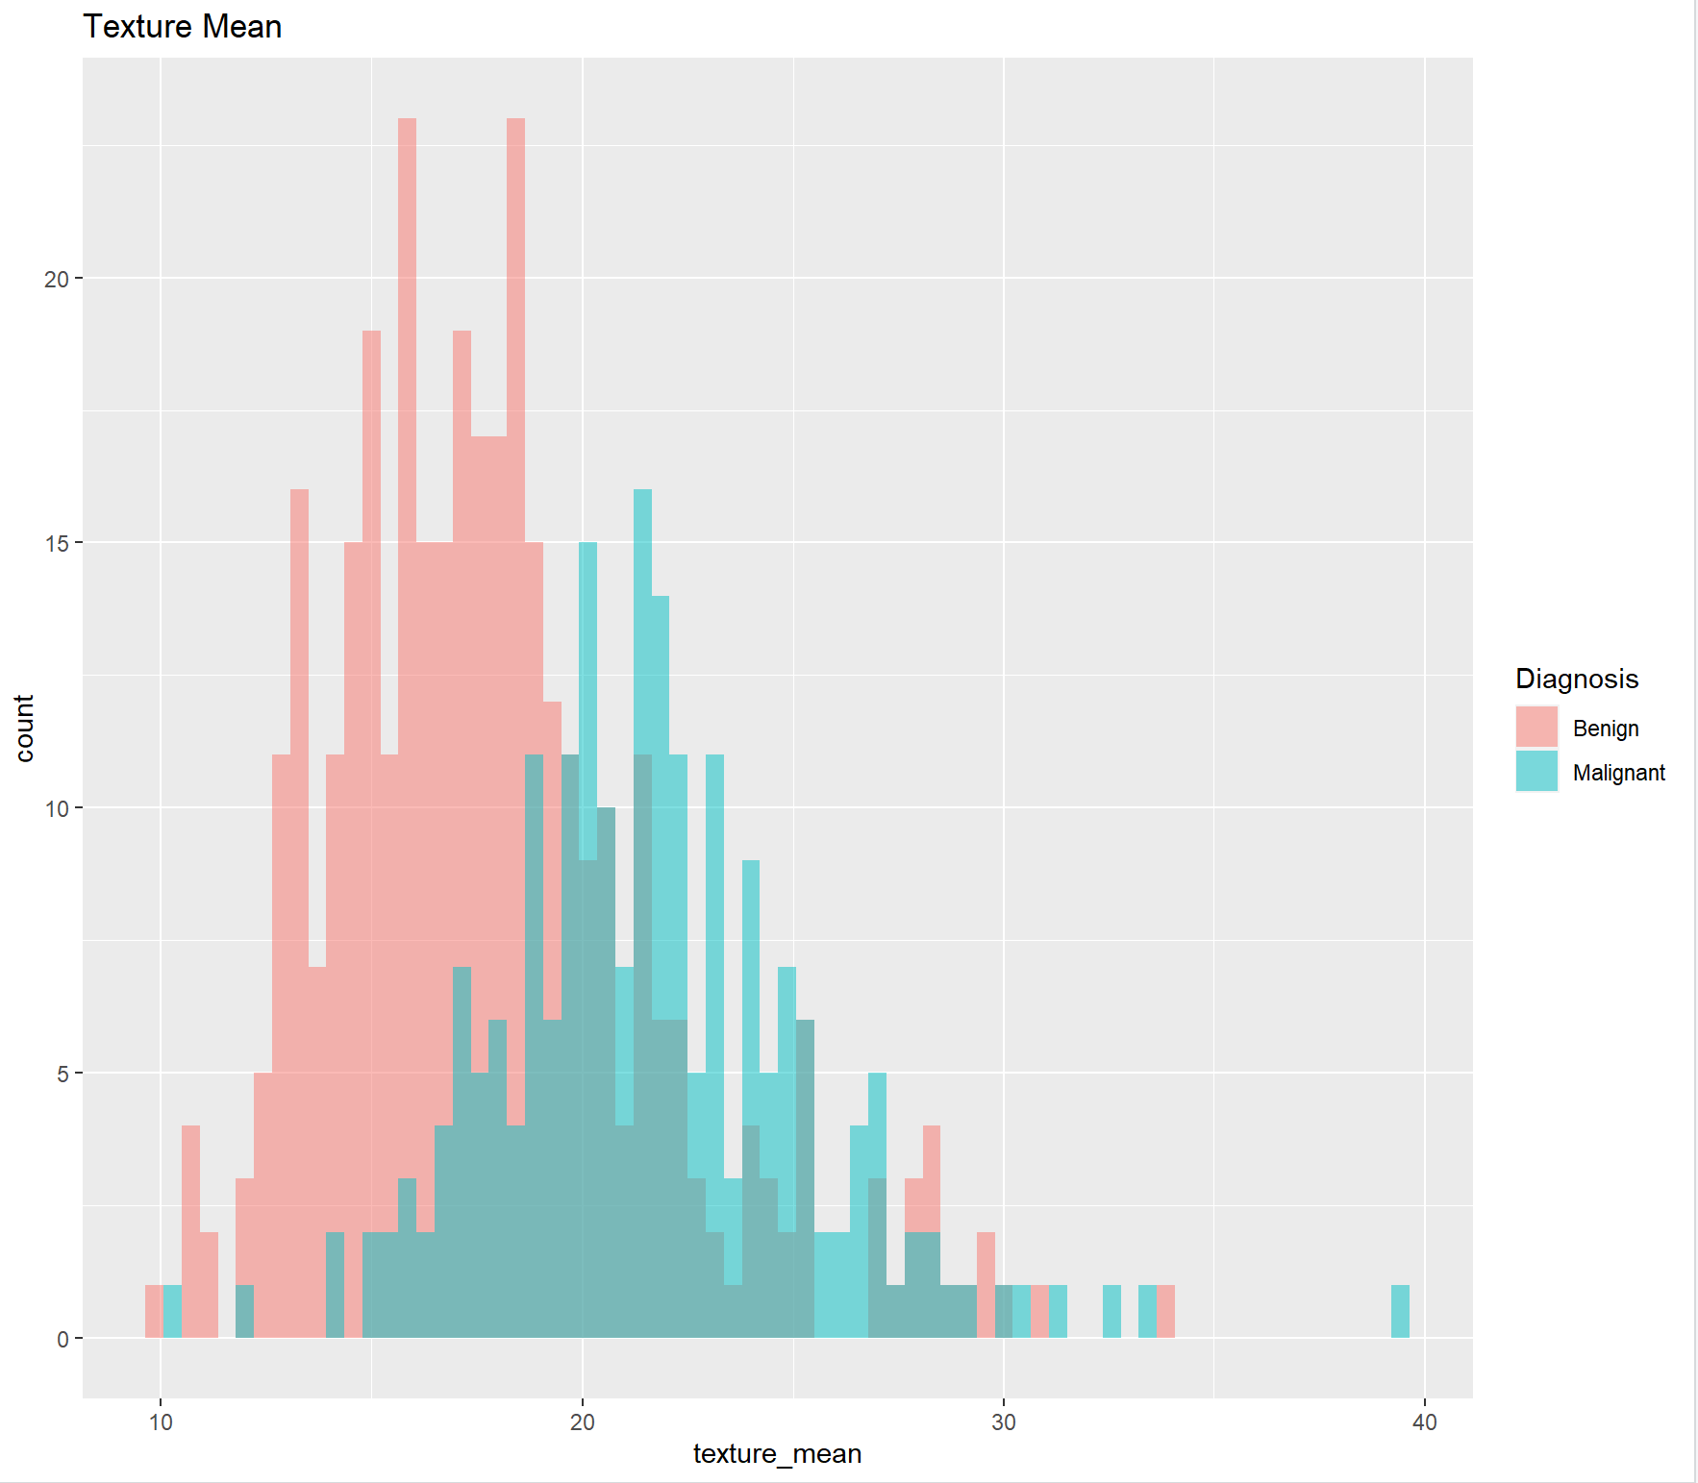
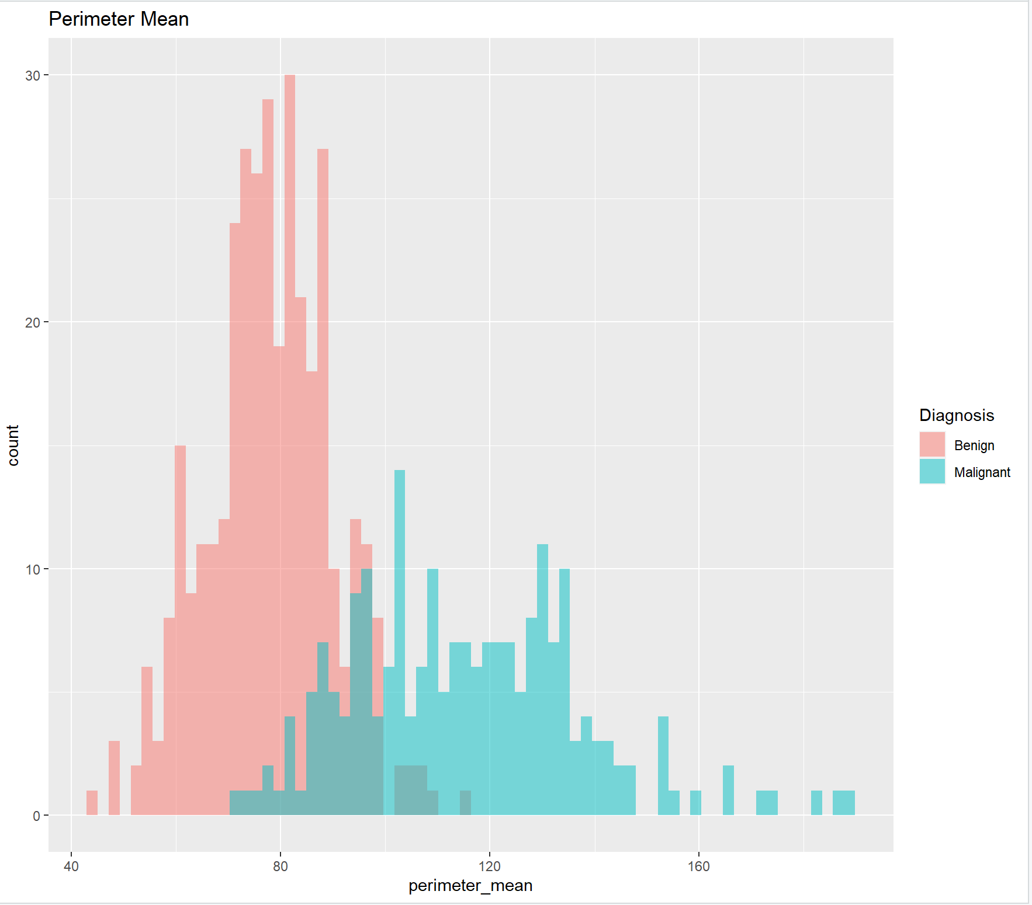
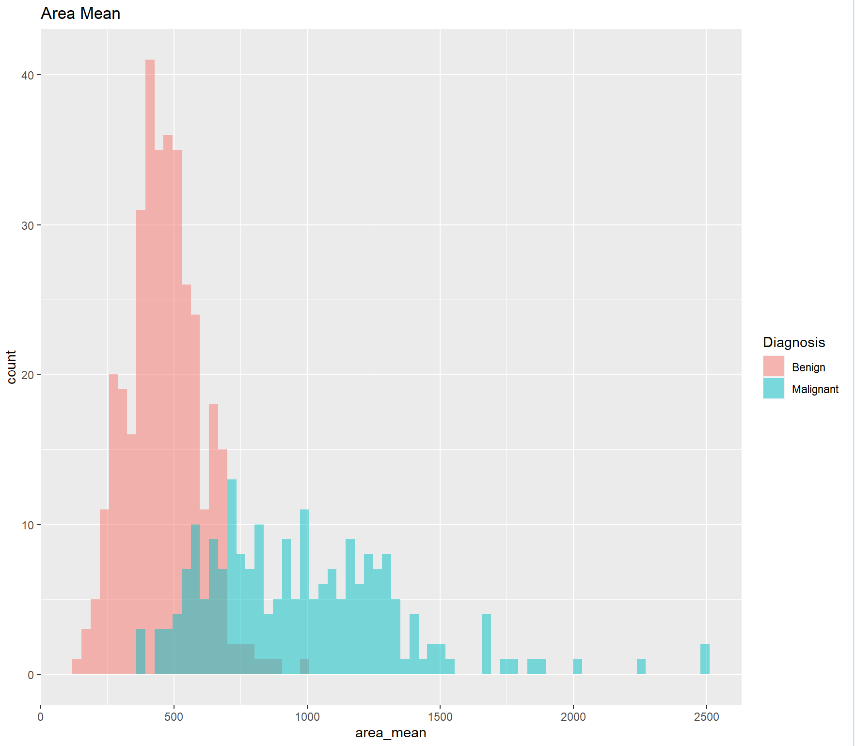
Analysis

Slide 8
Models
AdaBoost Classification- AdaBoost, short for Adaptive Boosting, is a machine learning algorithm that can be used for classification problems. The main idea behind AdaBoost is to combine weak classifiers to create a strong classifier.
Random Forest- Supervised Machine Learning algorithm that builds decision trees based off the data, the trees are then averages and it will return a prediction result
Gradient Boosting- Machine Learning Booster that tries to build the next best model off the previous models and in hopes, will minimize the error.

Slide 9
Top 10 Variables
concave.points_worst
area_worst
radius_worst
perimeter_worst
texture_worst
texture_mean
concance.points_mean
area_se
concavity_worst
concavity_mean
Performance Metric
- The performance metric that will be used is accuracy
Good measurement when measuring how often a model correctly predicts the outcome of a binary classification problem
Calculated by dividing the number of correctly classified instances by the total number of instances in the dataset. It is shown as a percentage, with a value of 100% indicating that the model has correctly classified all cases

Slide 10
Performance
Random Forest
Trees | Depth | Performance: Accuracy
300 | 3 | .9292
500 | 3 | .9204
300 | 5 | .9115
500 | 5 | .9292
Gradient Boost
Trees | Depth | Performance: Accuracy
300 | 3 | .9558
500 | 3 | .9667
300 | 5 | .9735
500 | 5 | .9558
AdaBoost
Trees | Depth | Performance: Accuracy
300 | 3 | .9735
500 | 3 | .9646
300 | 5 | .9735
500 | 5 | .9646

Slide 11
Average Performance
Random Forest
Trees | Depth | Average Accuracy
300 | 3 | 0.9256637
500 | 3 | 0.9265487
300 | 5 | 0.9309735
500 | 5 | 0.9274336
Gradient Boost
Trees | Depth | Average Accuracy
300 | 3 | 0.9743363 (Best)
500 | 3 | 0.9654867
300 | 5 | 0.9672566
500 | 5 | 0.9584071
AdaBoost
Trees | Depth | Average Accuracy
300 | 3 | 0.9663717
500 | 3 | 0.9690265
300 | 5 | 0.9699115
500 | 5 | 0.9707965

Slide 12
Conclusion
Average accuracies of each model were closer than I expected
Majority of the models didn’t change very much from its singular performance
Twelve different models were built and compared
Overall, best model with the highest accuracy was a Gradient Boosting model with 300 trees, a depth of 3 and an accuracy score of .9743363
Second was an AdaBoost model with 500 trees, a depth of 5 and an accuracy score of .9707965
Having an increase of estimators and depth from the Gradient model makes it more complex.

Slide 13





Implications and Further studies
Software
Software
Debug
STRATEGY
LAUNCH
Took a while to set up PyCharm to run R
Version of R in PyCharm wouldn’t accept all packages
Ran into unfamiliar errors
Learn more about software and use tools offered
Learn hyperparameter tuning and become familiar with more models

Slide 14
THANK YOU

